Slide 1
Intro to MATLAB
Workshop Lead: Meghana Munipalle
Date: October 21, 2026

Slide 2

Scan the QR code to sign up
for our mailing list!
Notes:
The McGill initiative on Computational Medicine was formed in 2017 and aims to deliver inter-disciplinary research programs and empower the use of data in health research and health care delivery
Located at the Genome Center
They have a newsletter were you can subscribe to
more info on the web site

Slide 3

Outline
Module 1: MATLAB Basics
Calculations on the command line
Programming in MATLAB
Exercises!
Module 2: MATLAB for Science
2D & 3D Plotting
Numerical Methods
Exercises!
Module 3: Additional Resources!

Slide 4
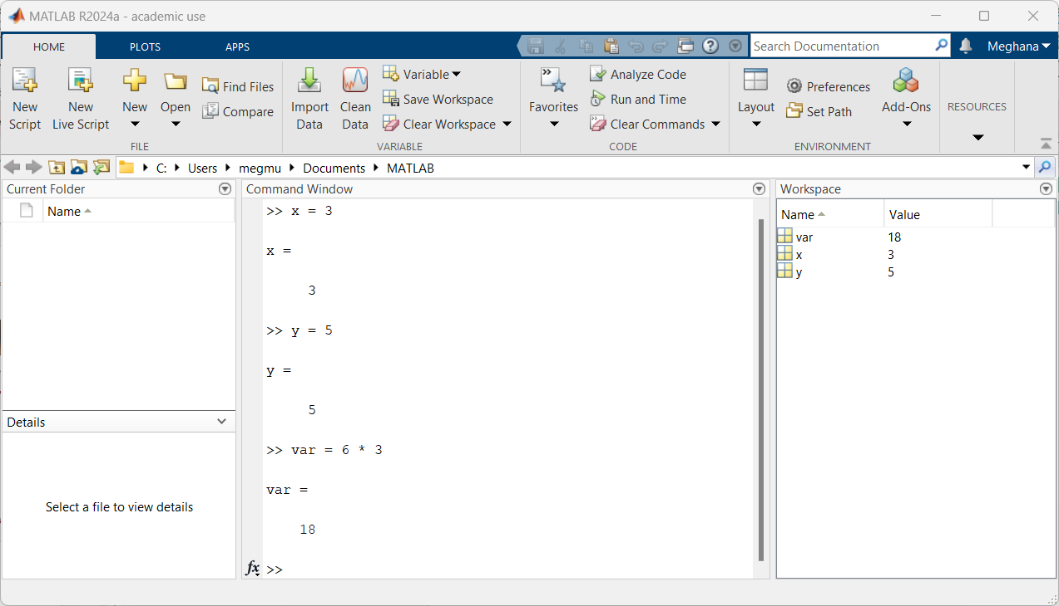
Getting Started
Module 1: MATLAB Basics
Tour of the environment

Slide 5

The command line
Module 1: MATLAB Basics
Code Along
Using MATLAB as a fancy calculator
Vectors, matrices, and arrays
Basic built-in functions
Notes:
MATLAB was created as a tool to make matrix algorithms much easier to work out!

Slide 6
Exercise 1: Command Line
Module 1: MATLAB Basics
Try It Out
Create a row vector of odd numbers through 21 (without simply listing all the numbers):
  L = 1 3 5 7 9 11 13 15 17 19 21
Find the sum of all elements in this vector using 1 command:
  [1, 3, -5, 24, 8, -76, 44, -2, 7, 13]
Calculate the hypotenuse of a triangle with side lengths 12 and 15 (try in 1 line!)
Type the following lines, pressing enter in between each
  p = (3*2)^2
  q = (3*2)^2;
  What is the difference between the outputs?
Form a 6 x 1 vector a of zeros using the zeros command

Slide 7
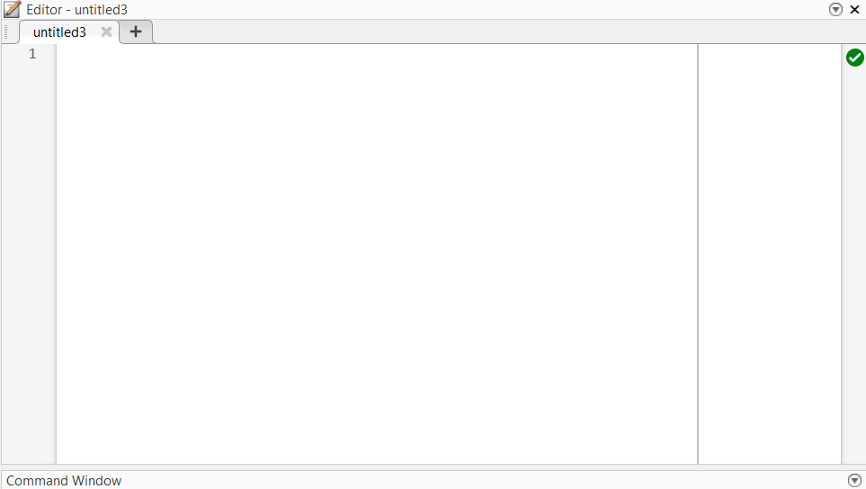
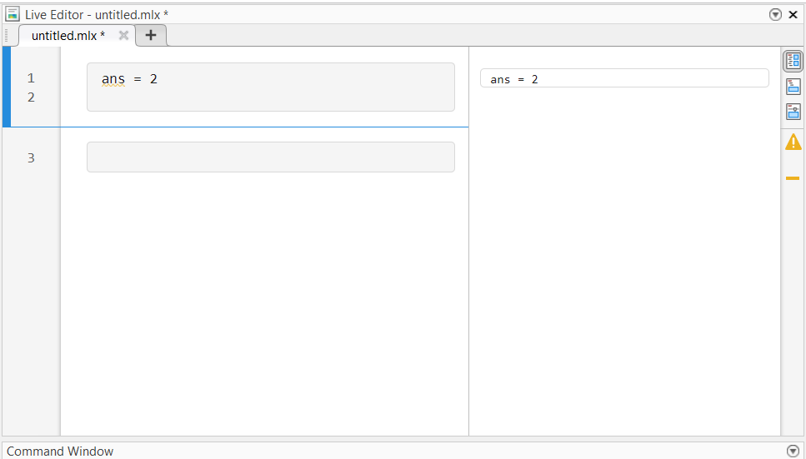
MATLAB Scripts
Module 1: MATLAB Basics
Code Along
Script (.m file)
Live script (.mlx file)

Slide 8
MATLAB Scripts
Module 1: MATLAB Basics
Code Along
Variables and functions
If-statements and loops
Text and characters
Basic errors and troubleshooting

Slide 9
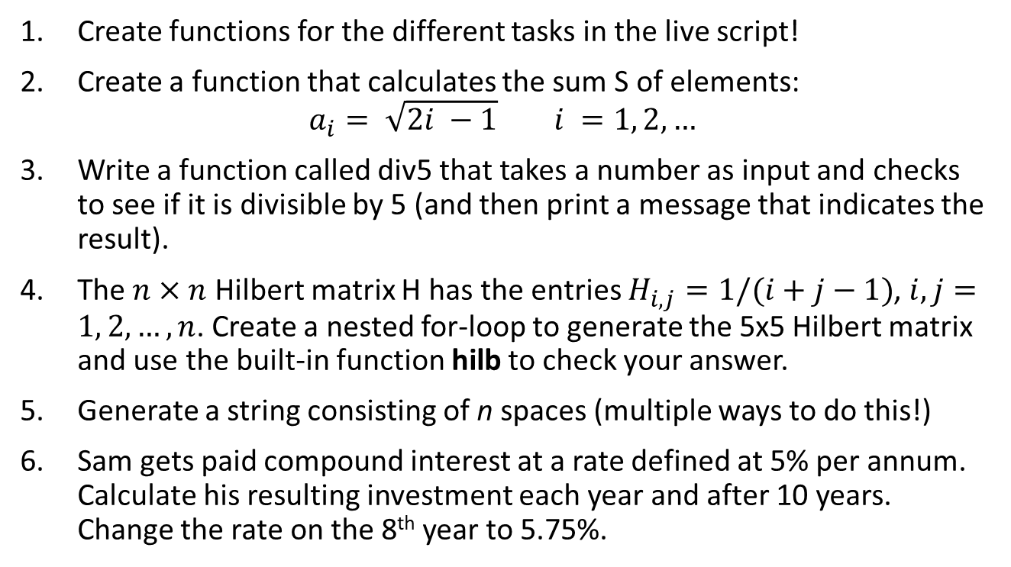
Exercise 2: Programming
Module 1: MATLAB Basics
Try It Out
Create functions for the different tasks in the live script!
Create a function that calculates the sum S of elements:
$$a_{i}= \sqrt{2i −1} i =1, 2, …$$
Write a function called div5 that takes a number as input and checks to see if it is divisible by 5 (and then print a message that indicates the result).
The $n×n$ Hilbert matrix H has the entries $H_{i, j}=1/(i+j−1)$, $i, j=1, 2, …, n$. Create a nested for-loop to generate the 5x5 Hilbert matrix and use the built-in function hilb to check your answer.
Generate a string consisting of n spaces (multiple ways to do this!)
Sam gets paid compound interest at a rate defined at 5% per annum. Calculate his resulting investment each year and after 10 years. Change the rate on the 8th year to 5.75%.

Slide 10
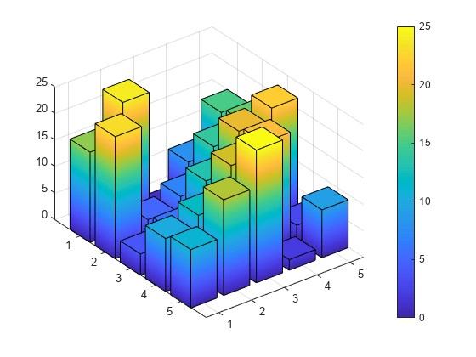
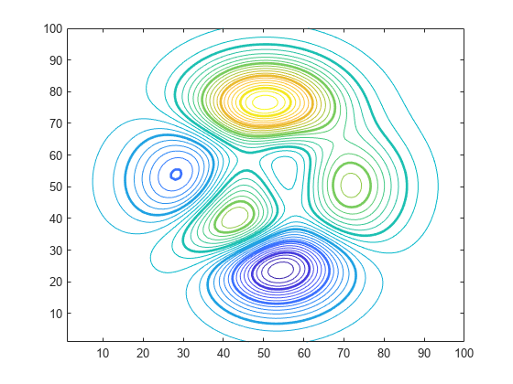
2D & 3D Plotting
Module 2: MATLAB for Science
Code Along
Basic plotting
Interacting with files

Slide 11
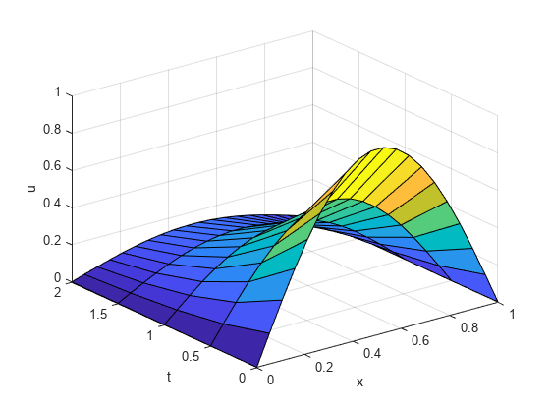
Some useful numerical methods
Module 2: MATLAB for Science
Code Along
Root finding
Solving differential equations
Curves of best fit

Slide 12
Exercise 3: Data Vis & Analysis
Module 2: MATLAB for Science
Try It Out
Work through activity3_qpcr.mlx
Work through activity3_penguins.mlx

Slide 13
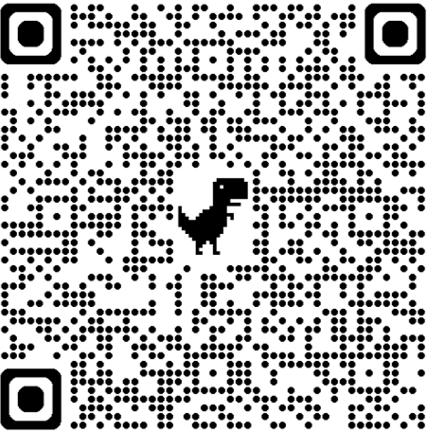
Let us know what you think!

Slide 14
Quick Links!
Module 3: Additional Resources
Want to learn more?
  MathWorks self-paced courses
  LinkedIn Learning – free through your student account
Want to get help?
  https://www.mathworks.com/help/matlab/ Main documentation- very extensive
  StackOverflow- a must ☺

Slide 15
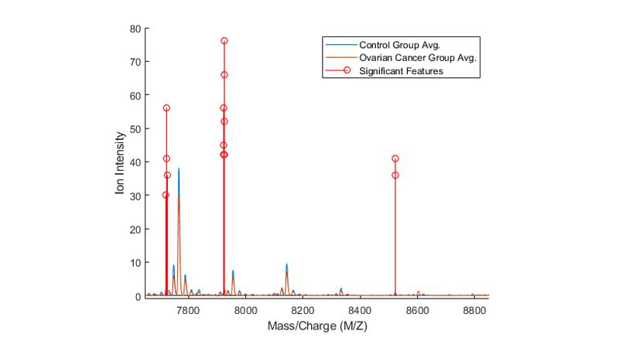
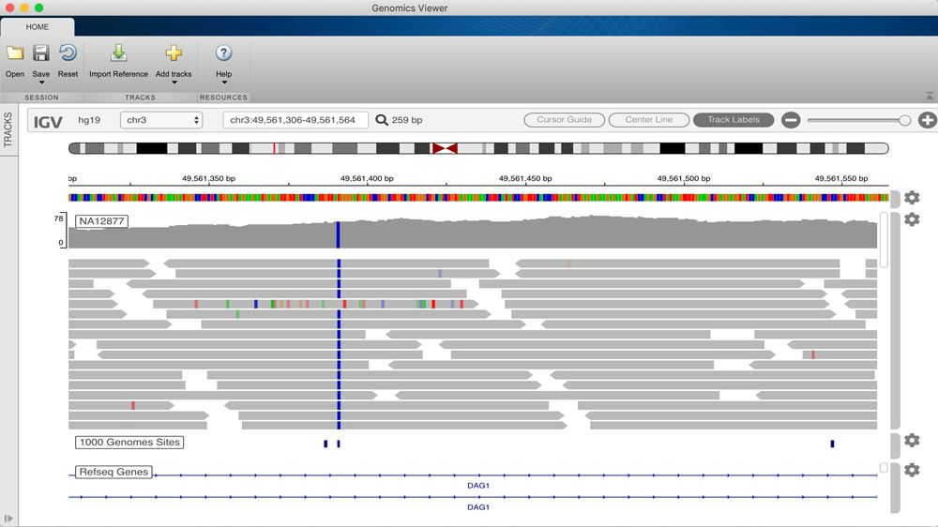
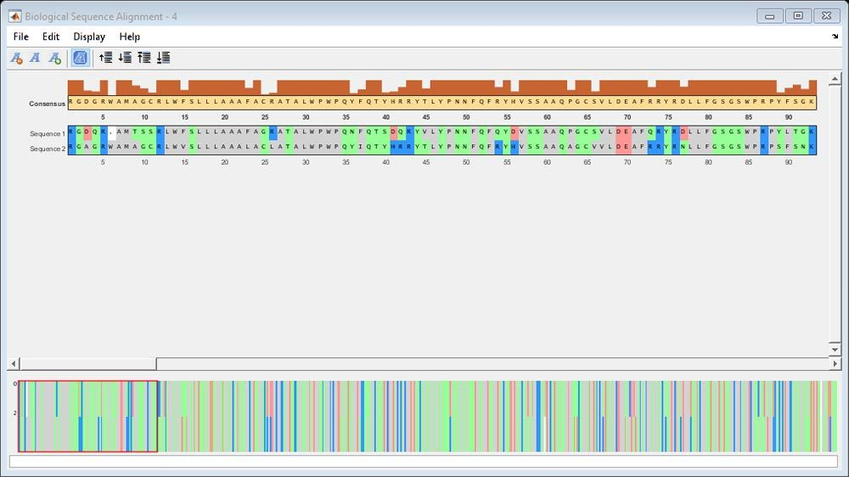
Tools for Computational Medicine
Module 3: Additional Resources
Bioinformatics Toolbox (option when installing)

Slide 16
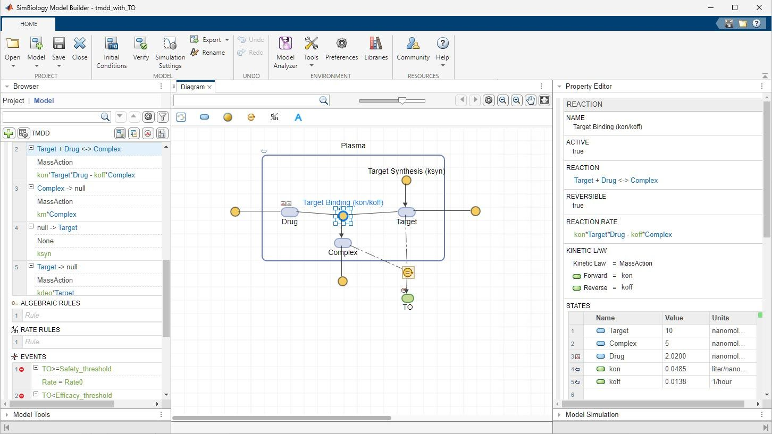
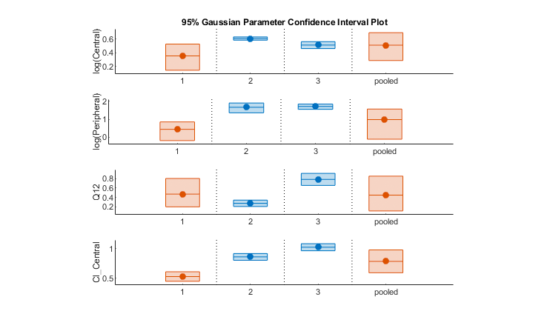
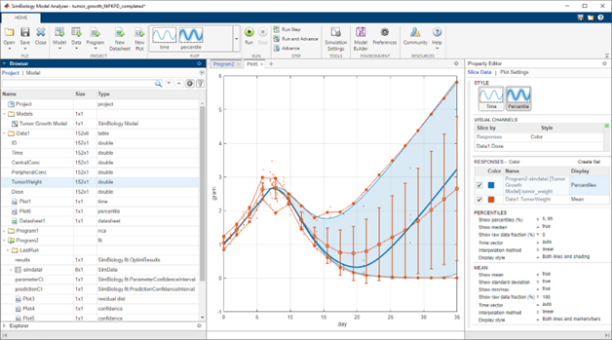
Tools for Computational Medicine
Module 3: Additional Resources
SimBiology (Simulink product)
ODE-based models (for pharmacokinetics, etc), Monte Carlo simulations, parameter estimation, tons of analysis!

Slide 17
To summarize
Now you are ready to:
Use MATLAB for many different types of calculations
Navigate the MATLAB command line and live scripts
Input, plot, and analyze data
Find tutorials and toolboxes specific to your research and/or interests!

Slide 18
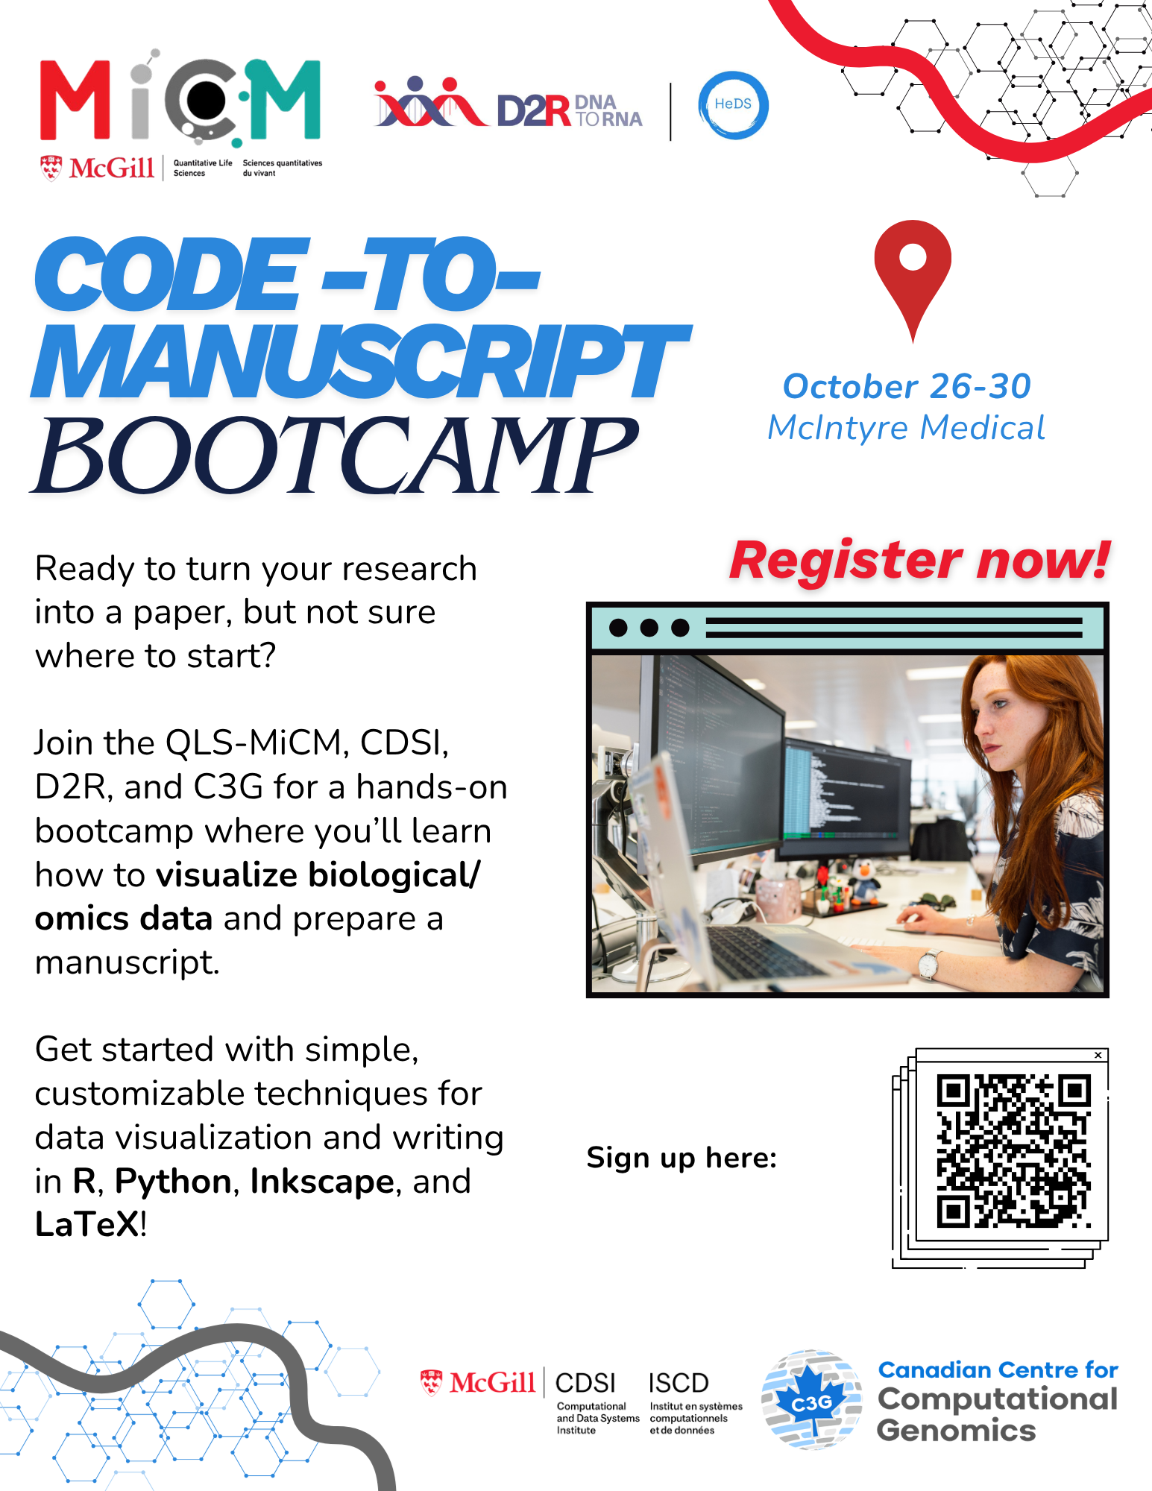

Slide 19
Thank you for attending!
Let us know what you think!

